Slide 1

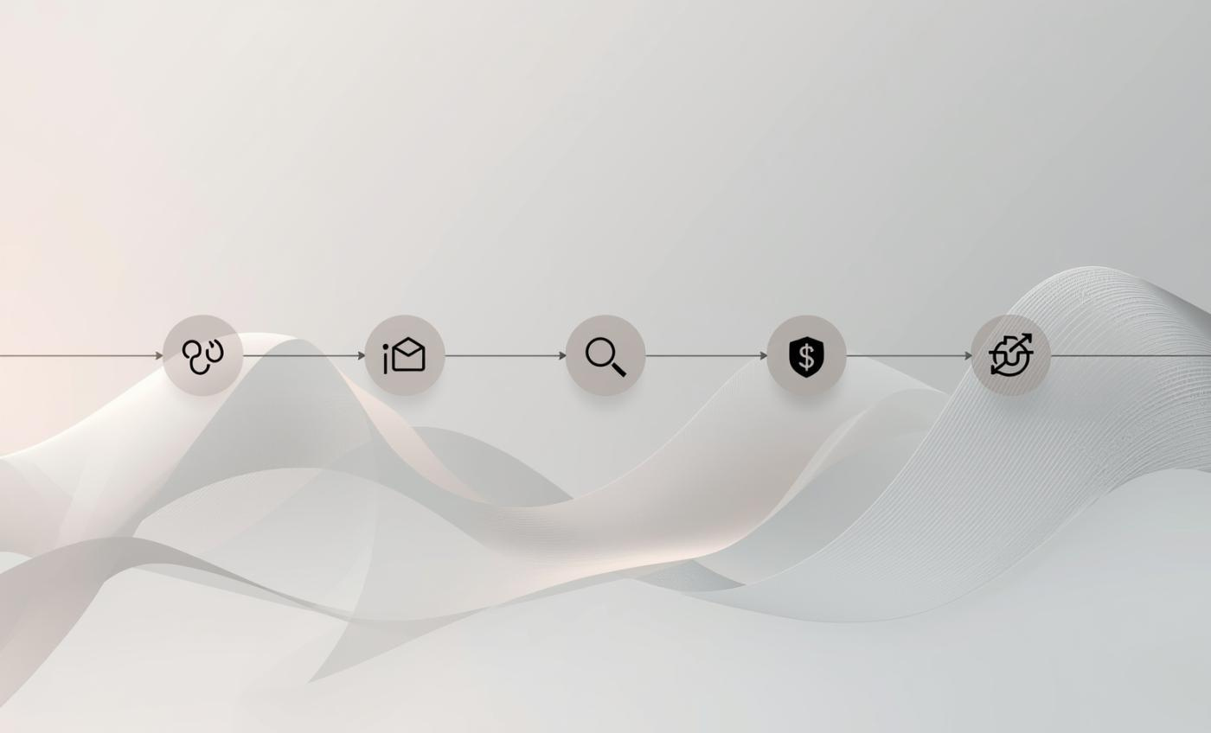





E-Commerce Funnel Conversion & Revenue Analysis
Analysis by
Kopano Mofokeng
Click Here:
|

Slide 2
Business Context
The objective of this analysis was to evaluate customer behaviour across the five-stage purchase journey: Product View, Add to Cart, Checkout, Payment, and Purchase.
The purpose was to identify conversion bottlenecks, assess traffic quality, and determine where optimisation efforts should be focused to increase revenue efficiently.
Specifically, the analysis sought to answer:
Where are customers dropping off in the funnel?
Which traffic sources bring high-quality users?
Where should optimisation efforts be prioritised to drive revenue growth?
The analysis covers the period 04 January 2026 to 02 February 2026 and compares performance against historical benchmarks.

Slide 3

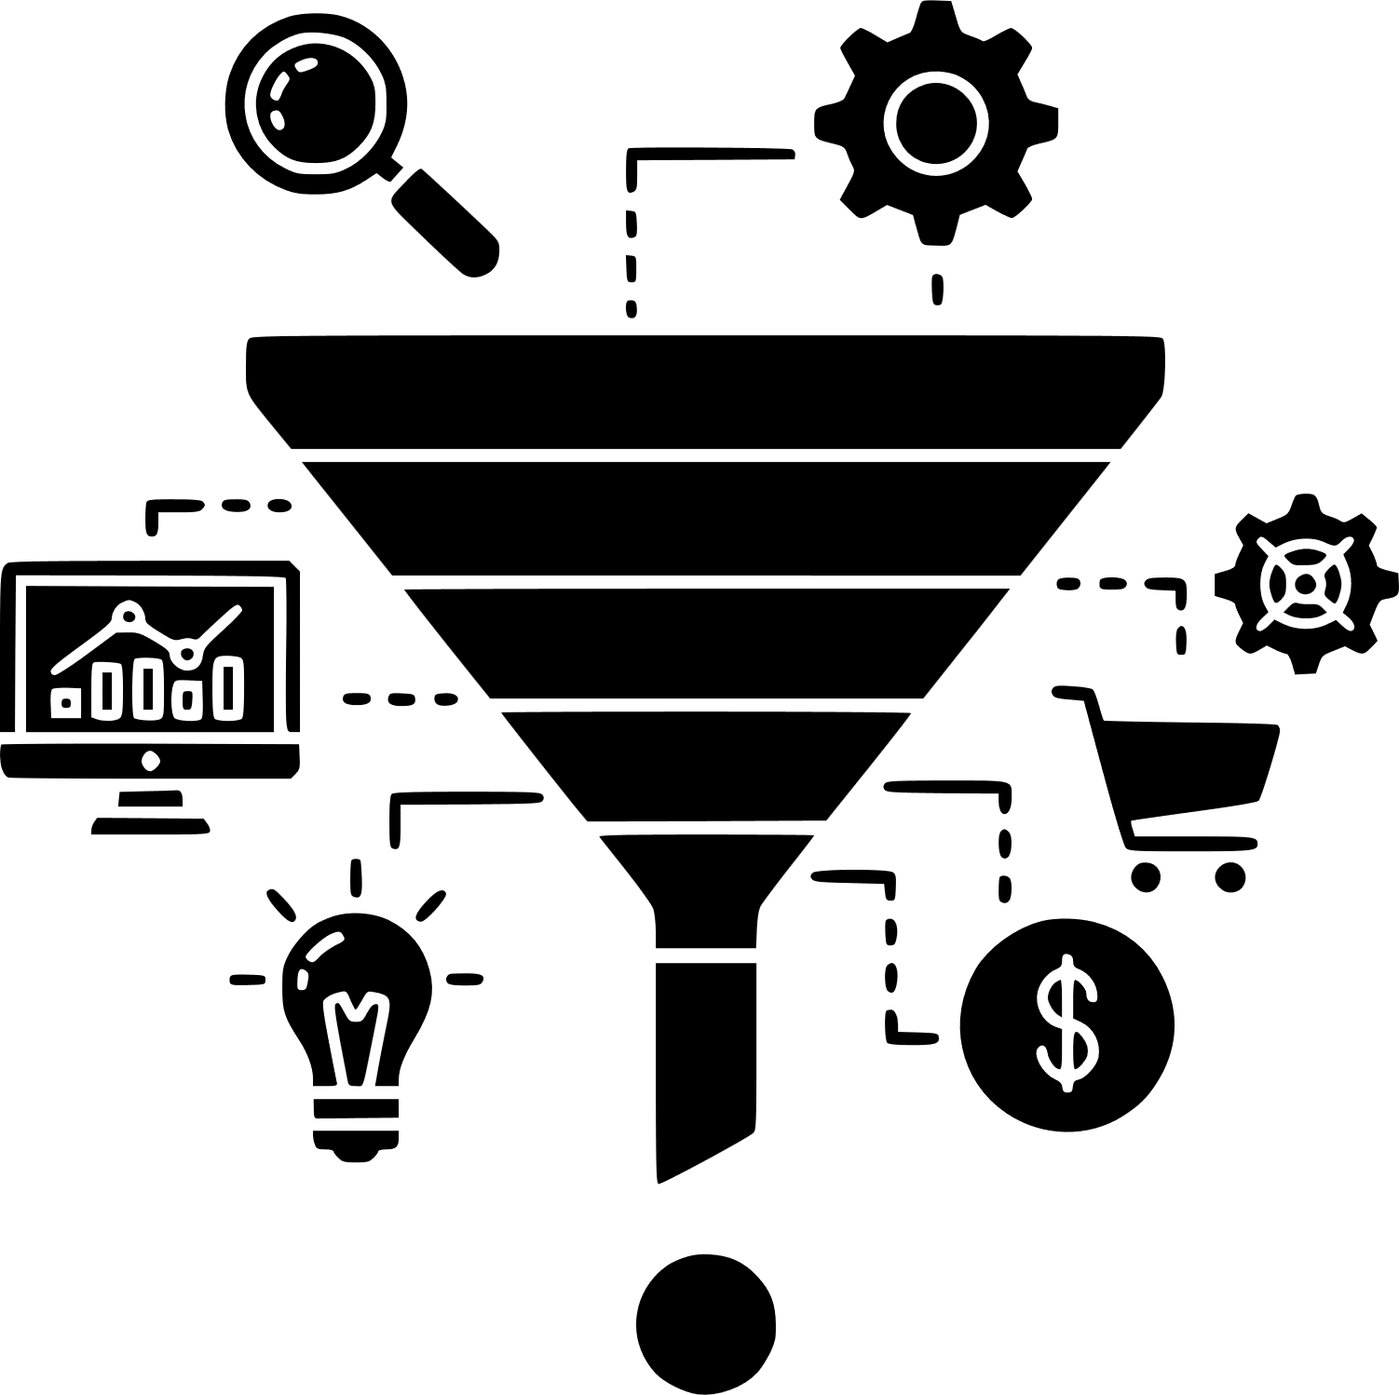
Funnel Performance Analysis
All-Time Data
5,000 Product Viewers
826 Purchases
All-time conversion rate: 16.52%
Analysis Period Funnel Data
4,272 Product Views
1,334 Add to Cart
951 Checkout
767 Payment Page
706 Purchases
30-day conversion rate: 16.53%
The largest drop-off occurs at the Product View stage. But once customers add items to their cart, conversion performance strengthens significantly:
More than half proceed to checkout
92% successfully complete payment
The similarity between the all-time conversion rate (16.52%) and the last 30-day rate (16.53%) indicates consistent funnel performance over time. The primary issue is not transaction failure, It is early-stage disengagement

Slide 4

Traffic Source Analysis
Conversion performance varies significantly by channel:
Email: 448 customers, 151 purchases = 34% conversion
Paid Ads: 821 customers, 173 purchases = 21% conversion
Organic: 1,750 customers, 298 purchases = 17% conversion
Social: 1,253 customers, 84 purchases = 7% conversion
This indicates that not all traffic is equally aligned with the product offering.
Social traffic, despite generating customers or visits, converts at less than one fifth of Email performance.
While Social drives traffic volume, it underperforms in conversion efficiency compared to Email and Paid Ads, indicating lower purchase intent
Traffic quality plays a major role in funnel progression.

Slide 5

Behavioural Insight Analysis
Time analysis shows that customers who progress past the Product View stage move efficiently through Checkout and Payment stage.
Customers spend an average of 11 minutes in the View stage, and
an average of 13 minutes between the four stages of Add to Cart and Purchase stage.
Most exits occur early, suggesting that customers may not be finding products that match their expectations when they land on the website.
This points to a potential misalignment between:
Audience targeting
Product assortment
Landing page experience

Slide 6

Revenue Insight Analysis
Revenue growth does not depend on fixing checkout.
Revenue growth depends on converting more of the 69% who exit at the Product View stage.
If we increase the View to Cart conversion rate even slightly, revenue will grow quickly because downstream conversion is already strong.
Increasing View to Cart conversion from 31% to 35% would push more customers into a funnel that already converts efficiently.
This would increase revenue without increasing traffic acquisition costs.

Slide 7

Revenue Insight Analysis
Revenue growth does not depend on fixing checkout.
Revenue growth depends on converting more of the 69% who exit at the Product View stage.
Since downstream conversion is strong, even a small increase in Add to Cart rate would have a significant revenue impact.
For example, increasing View to Cart conversion from 31% to 35% would push more customers into a funnel that already converts efficiently.
This would increase revenue without increasing traffic acquisition costs.

Slide 8

Recommendations
Improve audience targeting
Expand and diversify product offerings
Optimise product pages
Monitor View-to-Cart as a primary growth metric
Shift marketing budget toward high-converting channels such as Email and Paid Ads. Reassess targeting strategy for Social traffic, which converts at 7%.
A large number of customers leave at the Product View stage before adding anything to their cart. This suggests that many customers are not finding products that match what they expected when they clicked on our website. Introducing broader product options can capture more initial interest.
Improve product descriptions, visuals, reviews, and pricing clarity to encourage Add to Cart behaviour from customers.
This stage has the greatest revenue impact potential. Since downstream conversion performance is strong, even a small improvement in Add-to-Cart rates could significantly increase overall revenue. The focus should be on improving product relevance and customer targeting to capture more Product View stage customers.

